Slide 1
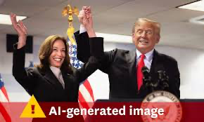
AI, Authenticity and the Trump/Harris Pheonmena
Gunn Enli, Professor
Department of Media and Communication
University of Oslo
Notes:
A German artist has rejected an award from a prestigious international photography competition after revealing that his submission was generated by Artificial Intelligence (AI).
Berlin-based Boris Eldagsen won the creative open category at this year’s Sony World Photography Award with his entry “Pseudomnesia: The Electrician.”
The eerie black and white image shows two women from different generations – the older woman appearing to hang on to the younger woman from behind.
ADVERTISING
Organizers said they were made aware of some AI involvement, but said there had been “deliberate” attempts to mislead them.
Eldagsen said he hoped his actions would open up the conversation around the issue and lead to “separate competitions for AI-generated images.”

Slide 2
Talk outline
AI –should we worry?
Authenticity – why does it matter?
Trump vs. Harris – authentic candidates?
Notes:
We start from the top. To what degree should we fear AI? I guess we should always fear for democracy, but its also important to disbelieve the hype about AI and its impact..

Slide 3
AI – a threat to democracy?
Fear for disinformation: increase spread of ‘deepfakes’ impacting the elections misleading voters and destroying democracy.
Deeepfakes: produced in higher quality and quantitaty and shared faster and more strategically microtargeted.
However, neither more, nor better deepfakes (supply) will make the demand larger, given that most people seek authoritative news sources.

Slide 4
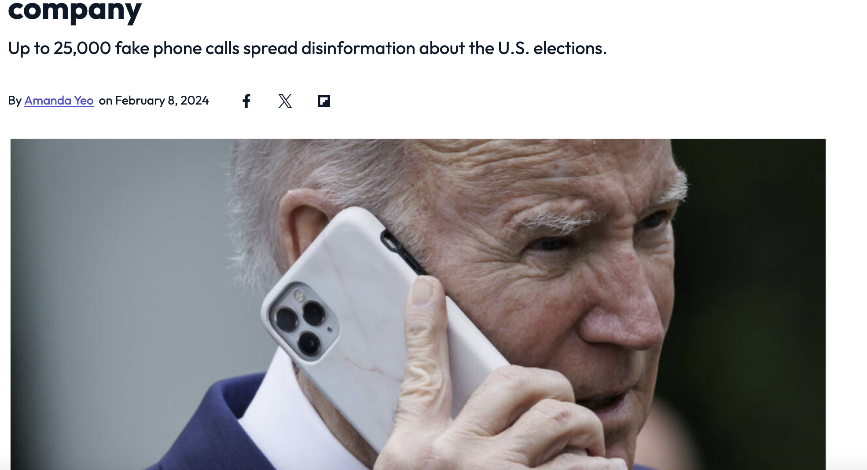
Democracies has shown resilience
Moral panic over new tech?
The third-person effect?

Slide 5
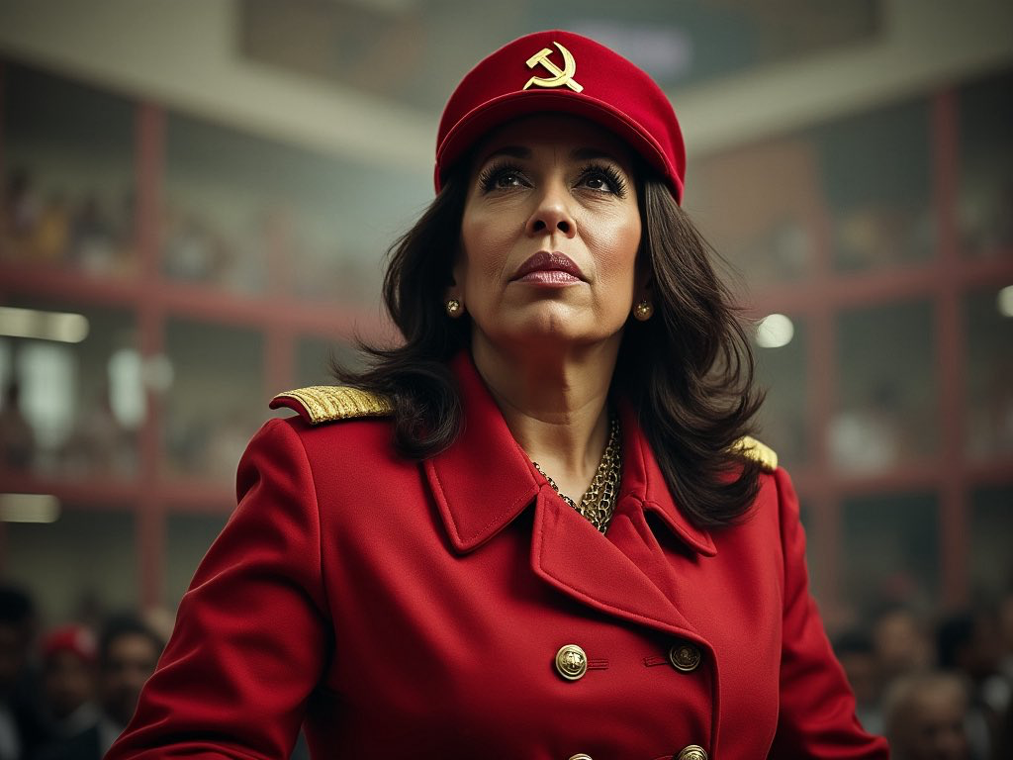
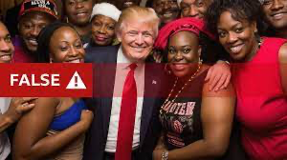
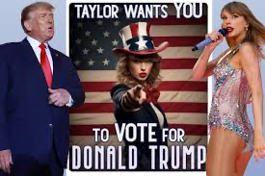
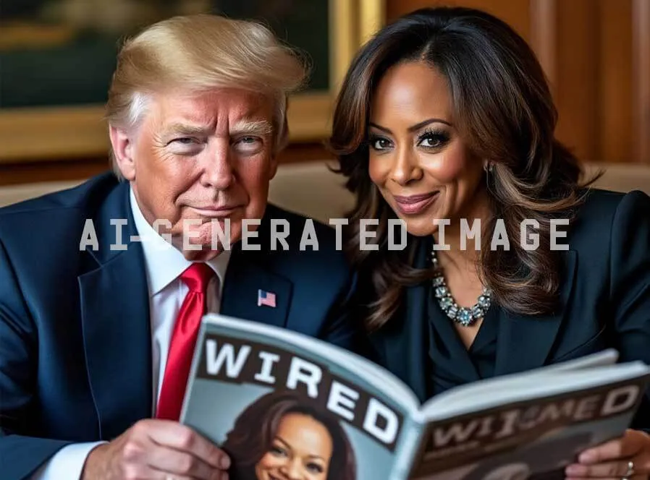
Trump vs. Harris
Algorithmic bias; white male vs. black female
A new celebrity: lack of benchmark datasets
Accuracy not the point: bad Harris images/memes on purpose to emphasize the idea that she is a fraud
Notes:
Vide of the two: Throughout the montage, Harris morphs into what look like different people, while the notably better Trump imagery remains fairly consistent.
Similarly, OpenAI’s ChatGPT and Google’s Gemini refused to produce images of Harris or Trump in WIRED’s testing. Meanwhile, a number of open source image generators will, like Grok, produce images of politicians. WIRED found one such model, Stable Diffusion, also produced not-great pictures of Harris.

Slide 6
Authenticity – why does it matter?
Performance matters in media-centred politics because a majority of voters is not that interested in politics.
Authentic performances promises trustworthiness and makes it possible for voters to connect with the candidate.
Authenticity is a currency in which strengthens the political message (I know this, because I grew up in a middleclass family etc.)
Being real is a normative value in society, as a counter-value to professionalized campaigns, as well as AI and everything fake.
Notes:
“The images are not being created to be photorealistic but rather are being created to push a narrative,” says Hany Farid, an expert on deepfake detection and cofounder of GetReal Labs, a startup off
Meme-worthy scenarios
Not intended as disinformation, but as ideas, interpretations,

Slide 7
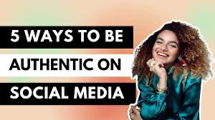
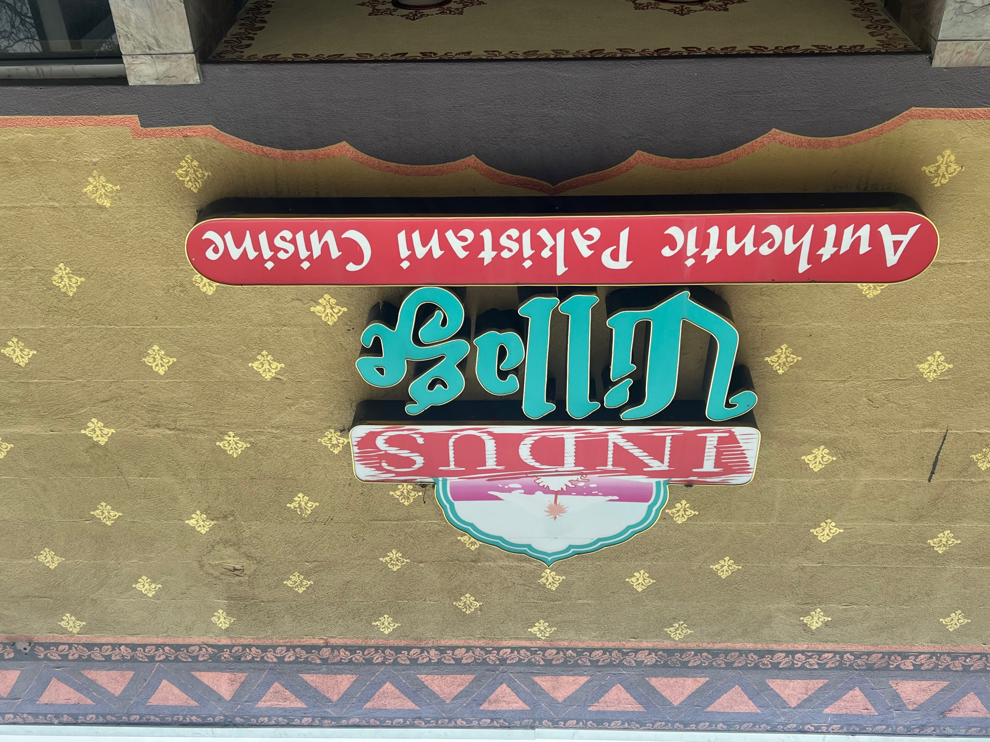
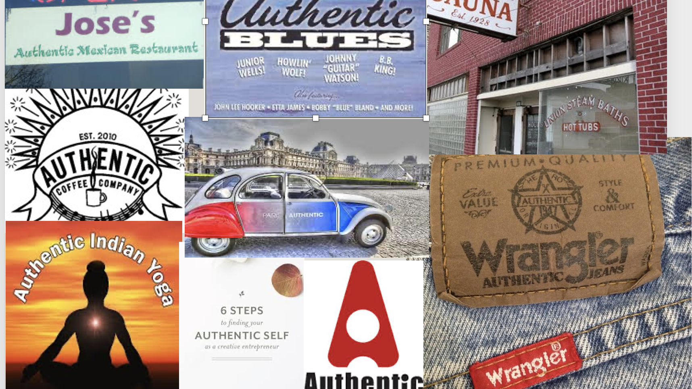
Notes:
Authenticity is everywhere in the culture. We seem to be obsessed with authenticity. Products, brands and ideas, because it is powerful and promises an added value to the products, unspecified, but real and genuine, and therefore better. Why are we obsessed with authenticity now? Is there something in the often used to brand and symbolically enrich products, activities and lifestyles.

Slide 8
7 performative strategies
1. Predictability
2. Spontaneity
3. Immediacy
4. Storytelling
5. Ordinariness
6. Ambivalence
7. Imperfection

Slide 9
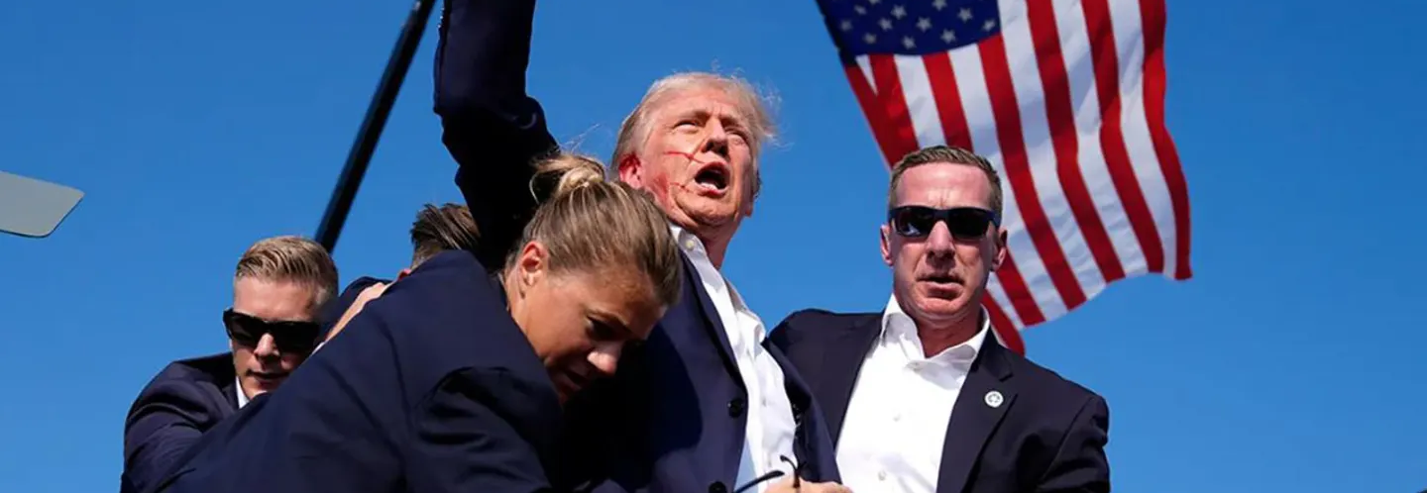
Trump- the authentic outsider

Slide 10
Trump’s authenticity
Consistency as a populist truth-teller; breaking the rules
Spontaneity as unscripted, stream-of-consiousness
Immediacy - communicates in real time via Twitter/X Truth Social
Storytelling - narrative as a rich, successfull celebrity
Ordinariness – in taste and lifestyle (eating mcDonalds etc)
Ambivalent – as an outsider (“I am not a politician”)
Imperfection – mistakes, errors, lies, law suits

Slide 11
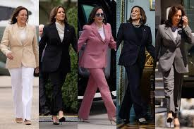
Harris - the first authentic female candidate?
Authenticity and gender:
more vulnerable to criticism
May (UK) + Clinton (USA) both described as ‘robotic’
Authenticity and race:
questions of being authentic American
accused of mimic authentic speech (Obama)

Slide 12
Harris’ authenticity
Consistency in style (clothes, looks), but questions about accent
Spontaneity seems to laugh spontaneous and unconstrained
Immediacy -confesses about private issues (Oprah etc)
Storytelling - middle class, struggles of a single mother etc.
Ordinariness – ordinary experioences, worked at McDonalds
Ambivalent – accidential candidate (no primaries)
Imperfection – word salads

Slide 13
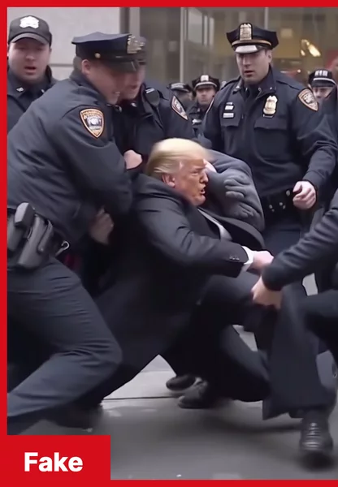
TAKE AWAY POINTS AI is a mirror of our history, reflecting backwards. Impact on elections seems (so far) overblown. But: Every new media technology shakes up trust relations and involves a renegotiation the 'authenticity contract’. Trump was the authentic outsider in 2016, helped by Twitter. Harris has an element of fresh authenticity, helped by TikTok

Slide 14
Thank you!
gunn.enli@media.uio.no

