Slide 1
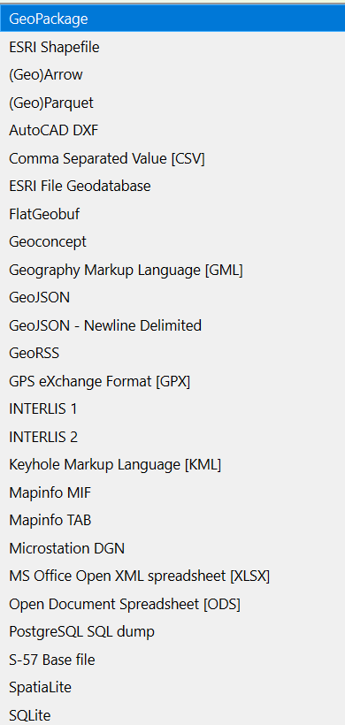
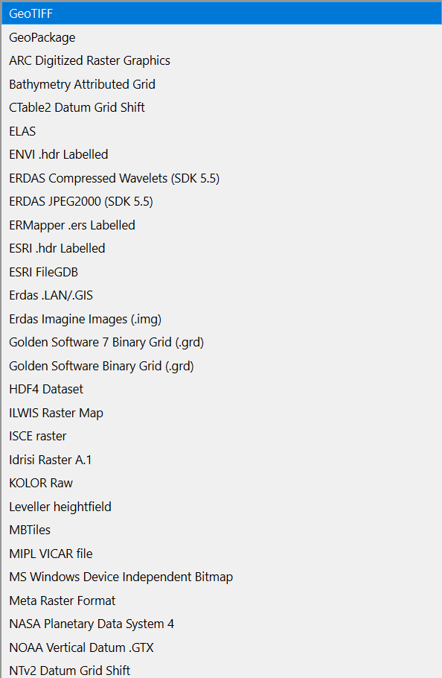
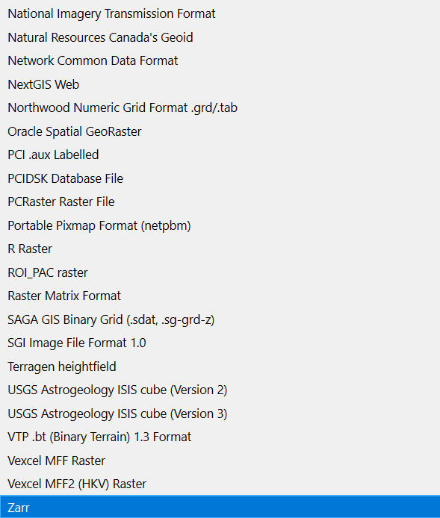
Spatial data formats
VECTOR
RASTER
Points, Lines, Polygons
Continuous gridded surface
Format lists via QGIS

Slide 2
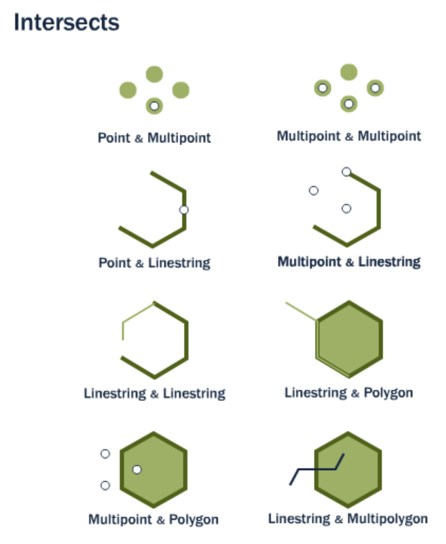
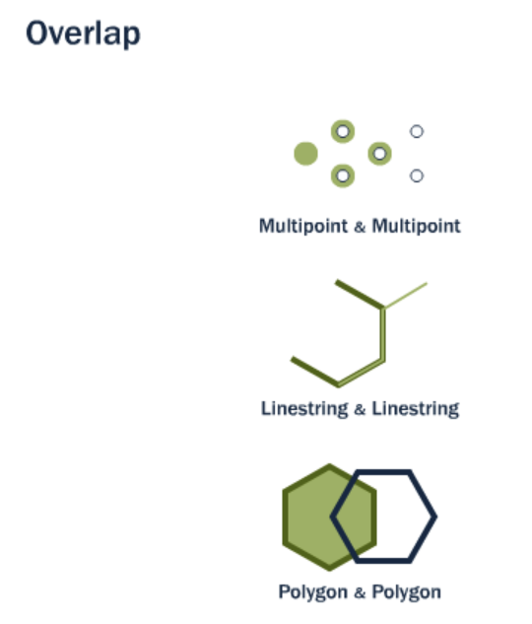
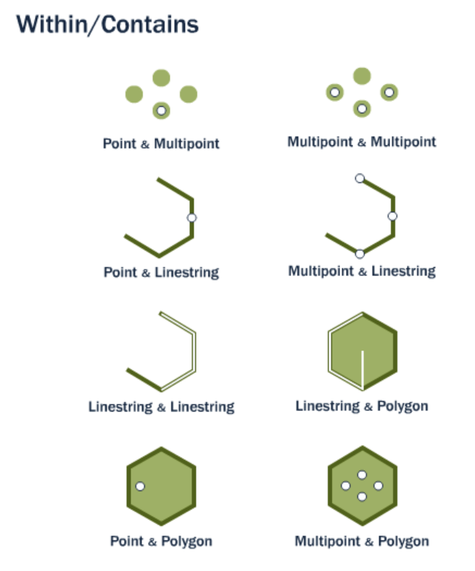
Spatial relationships (partial list)
https://postgis.net/workshops/postgis-intro/spatial_relationships.html

Slide 3
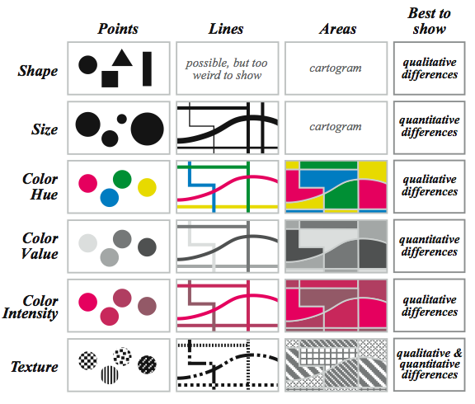
Visual variables
http://understandinggraphics.com/wp-content/uploads/2010/01/retinal-variables.png

Slide 4
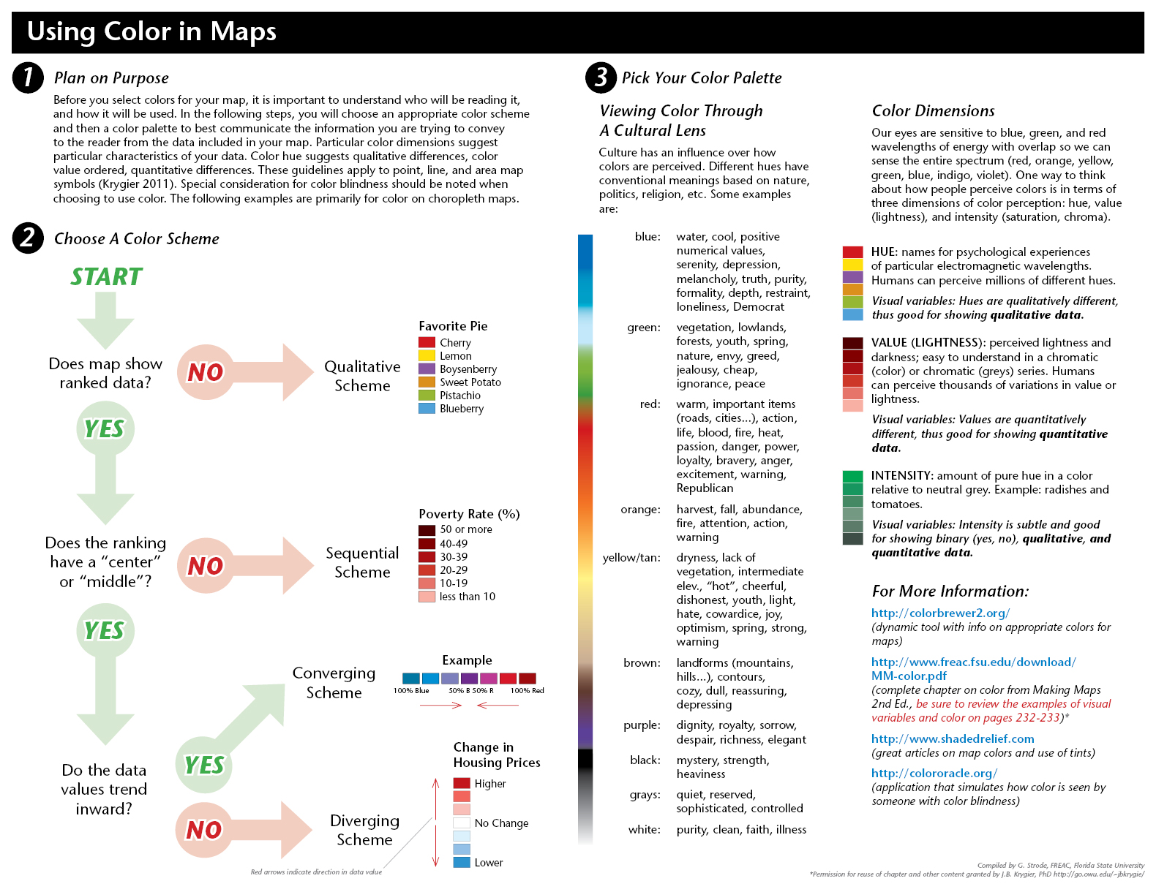
Color options (general)

Slide 5
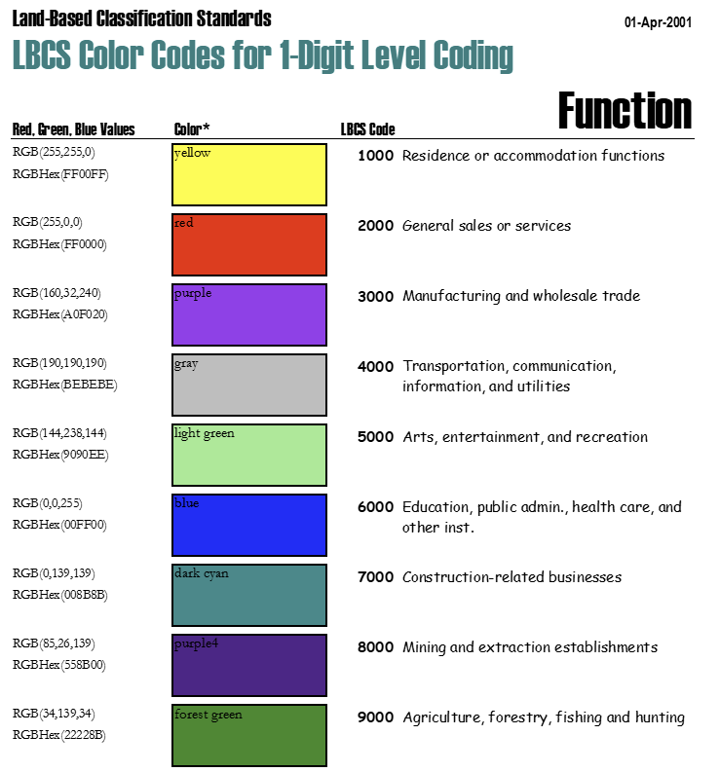
Color options (specific)
Such as …
American Planning Association
“Land Based Classification Standards”
https://www.planning.org/lbcs/standards/

Slide 6
Cartographic techniques, options, pitfalls, and more

Slide 7
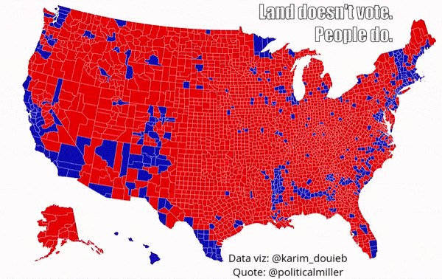
2016 Presidential Election results by county
https://www.core77.com/posts/90771/A-Great-Example-of-Better-Data-Visualization-This-Voting-Map-GIF#

Slide 8
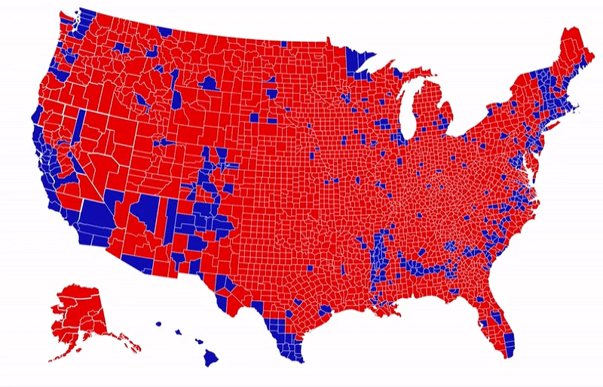
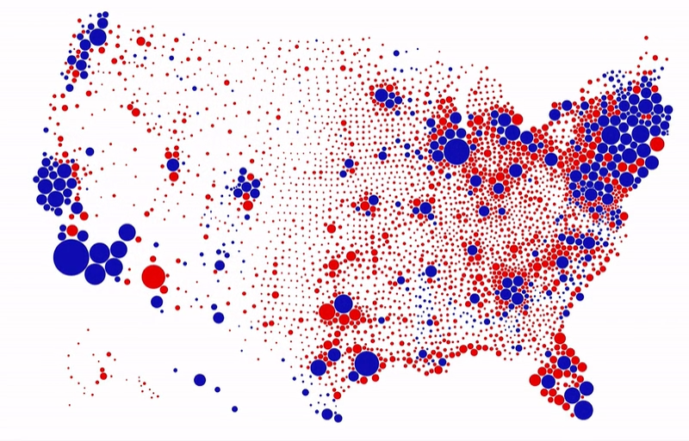
“Land doesn’t vote, people do.”
https://www.reddit.com/r/MapPorn/comments/sjt7v9/land_area_vs_population_for_us_presidential/?rdt=41743

Slide 9
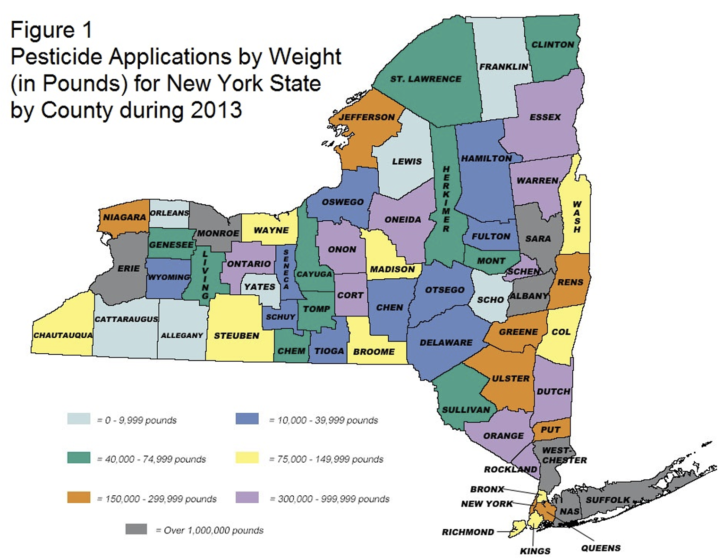
https://dec.ny.gov/environmental-protection/pesticides/pesticide-reporting-law/annual-report-data/prl-reports

Slide 10
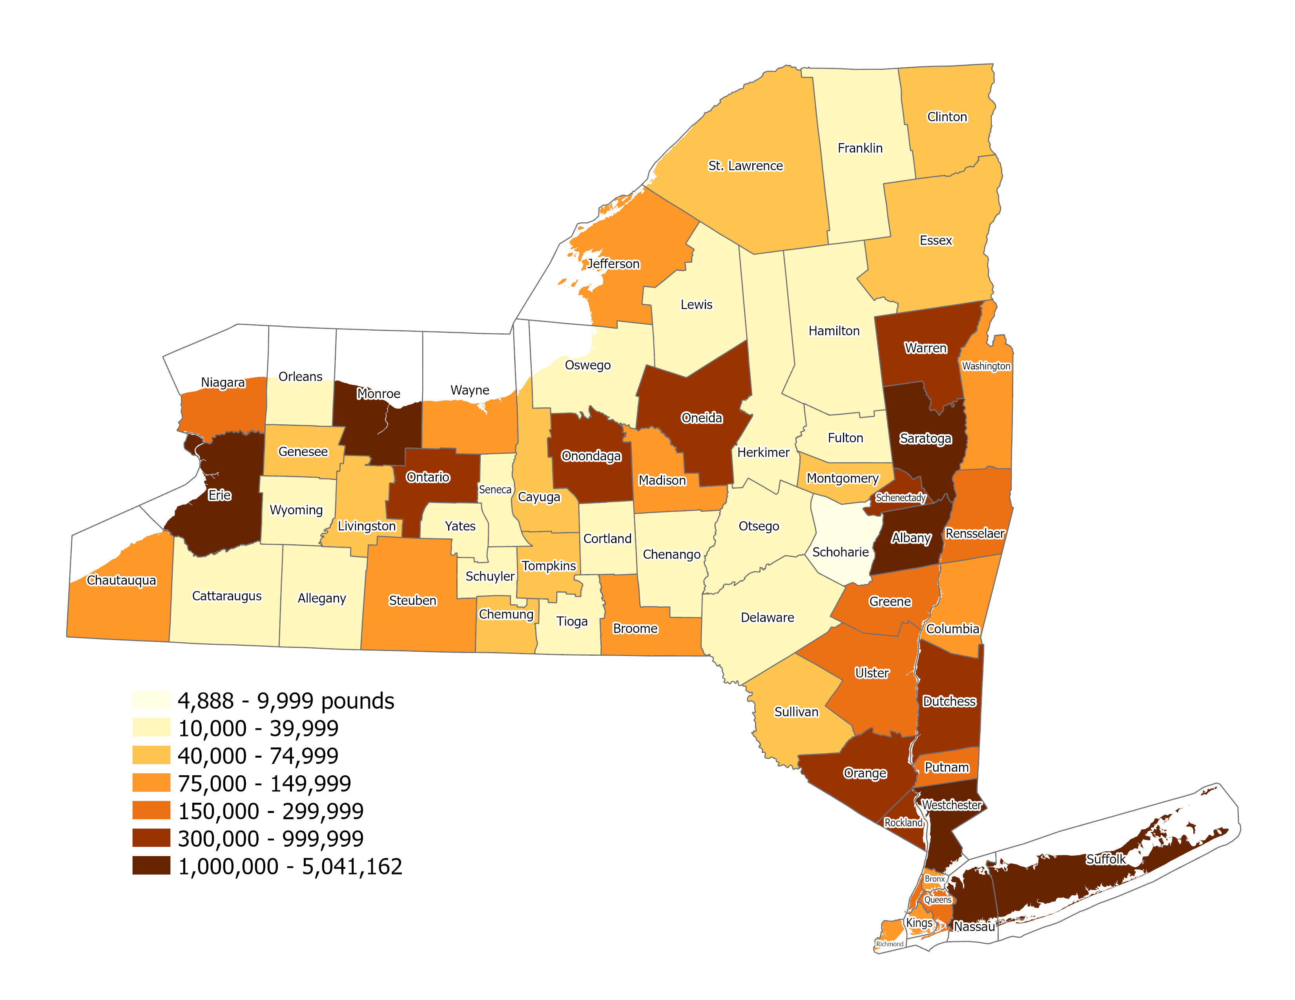
Pesticide Applications in Pounds
2013
Choropleth map

Slide 11
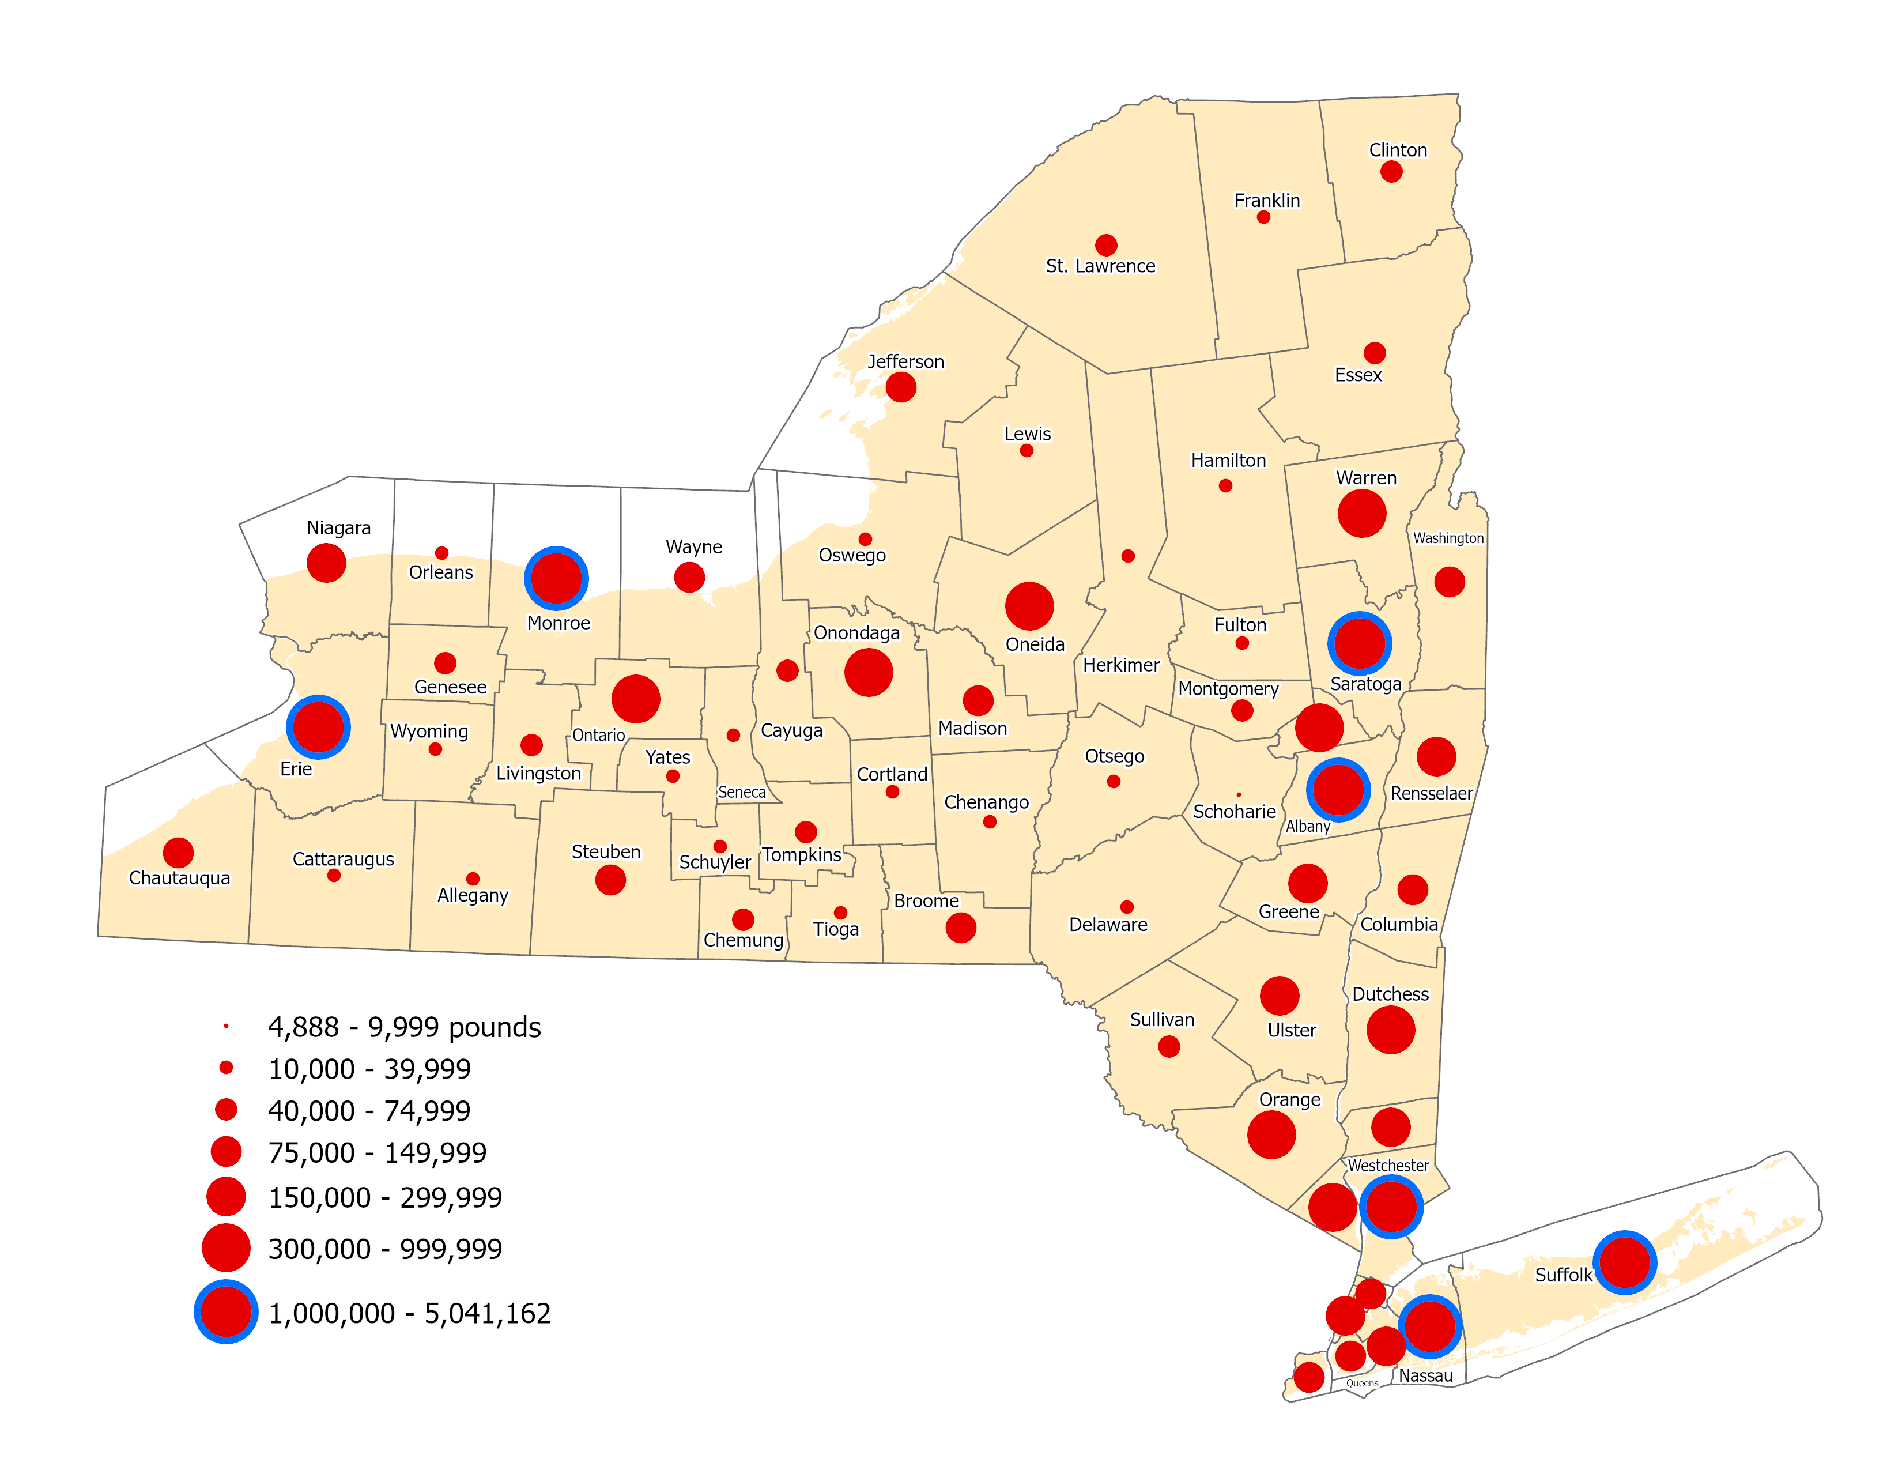
Pesticide Applications in Pounds
2013
Graduated Symbol map

Slide 12
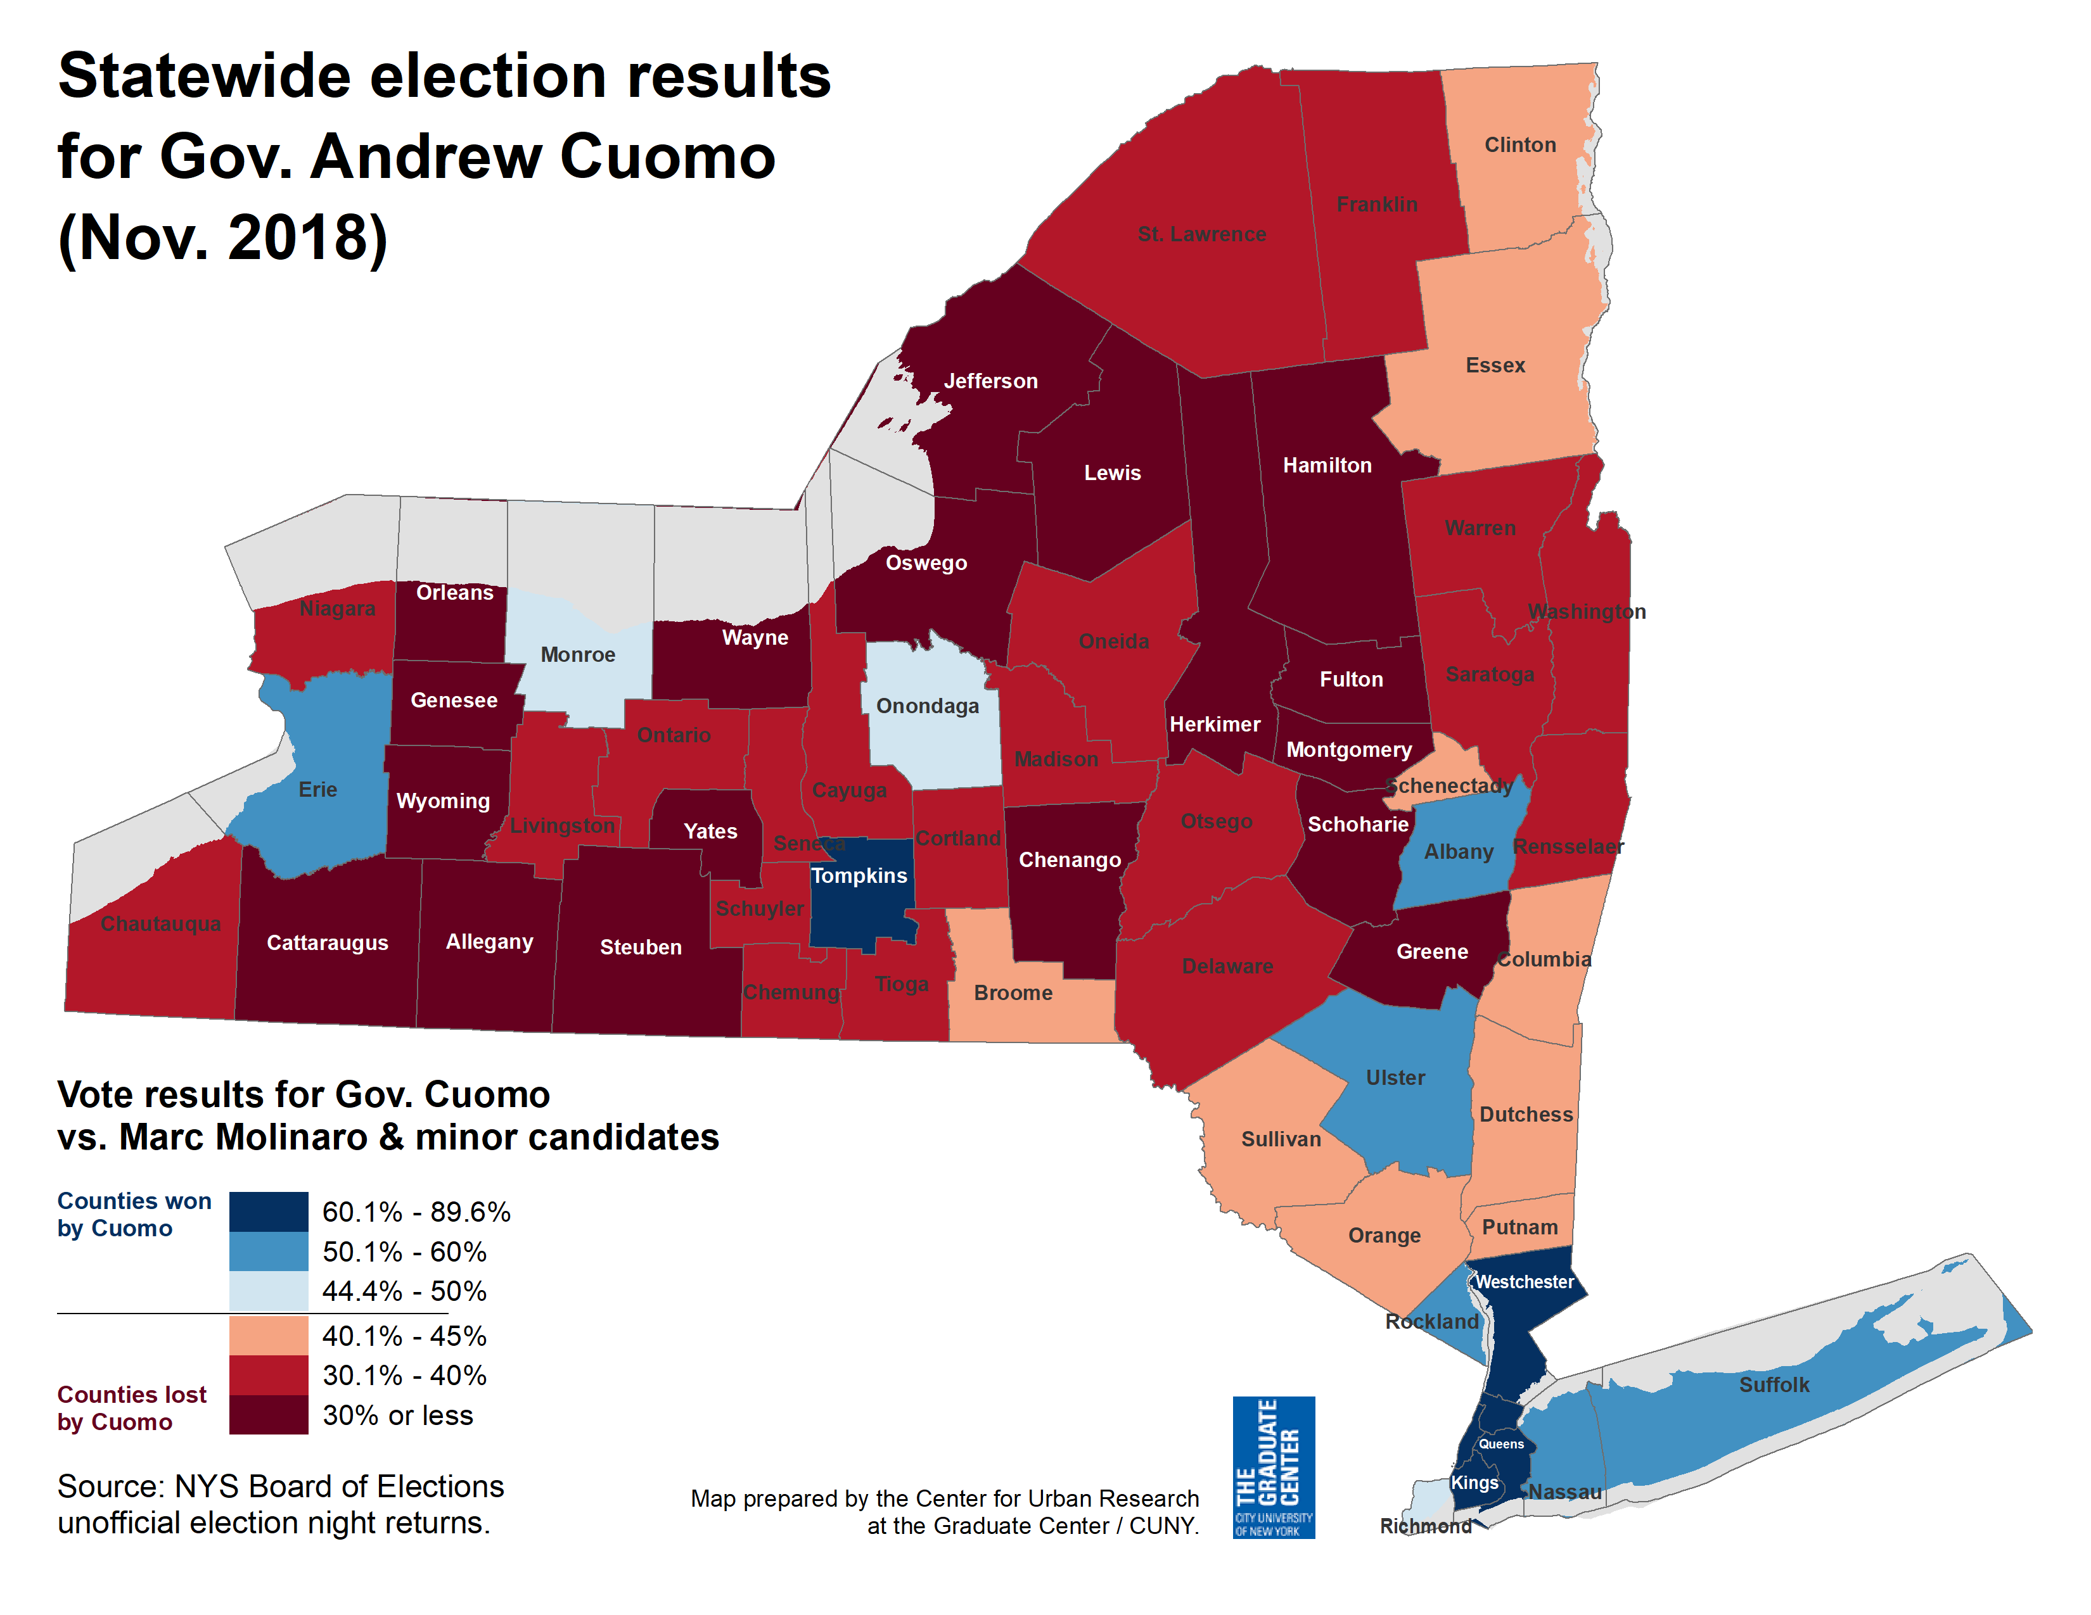

Slide 13
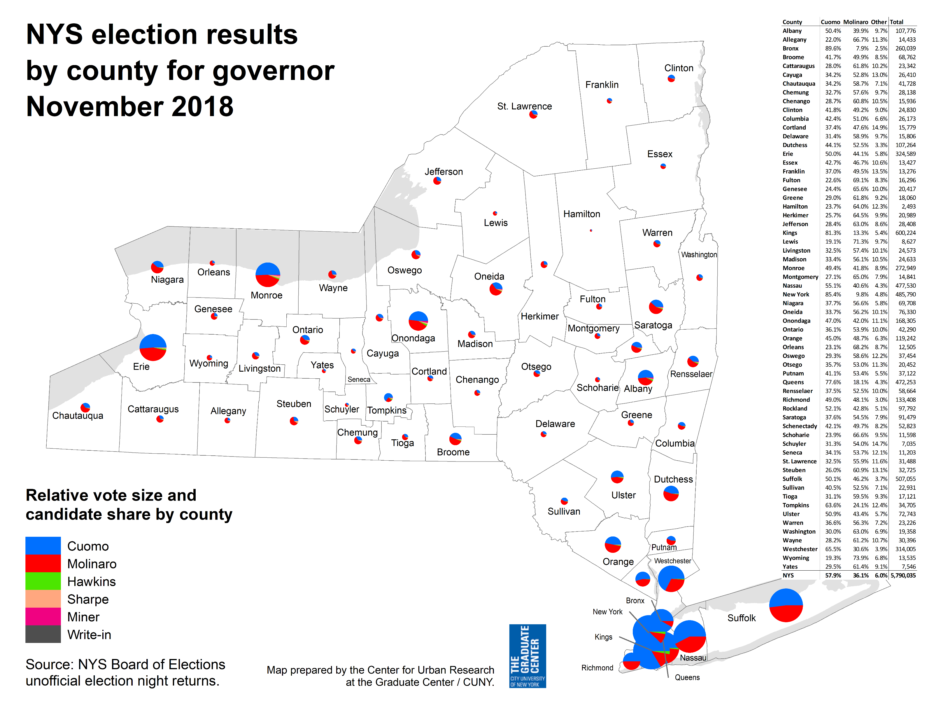

Slide 14
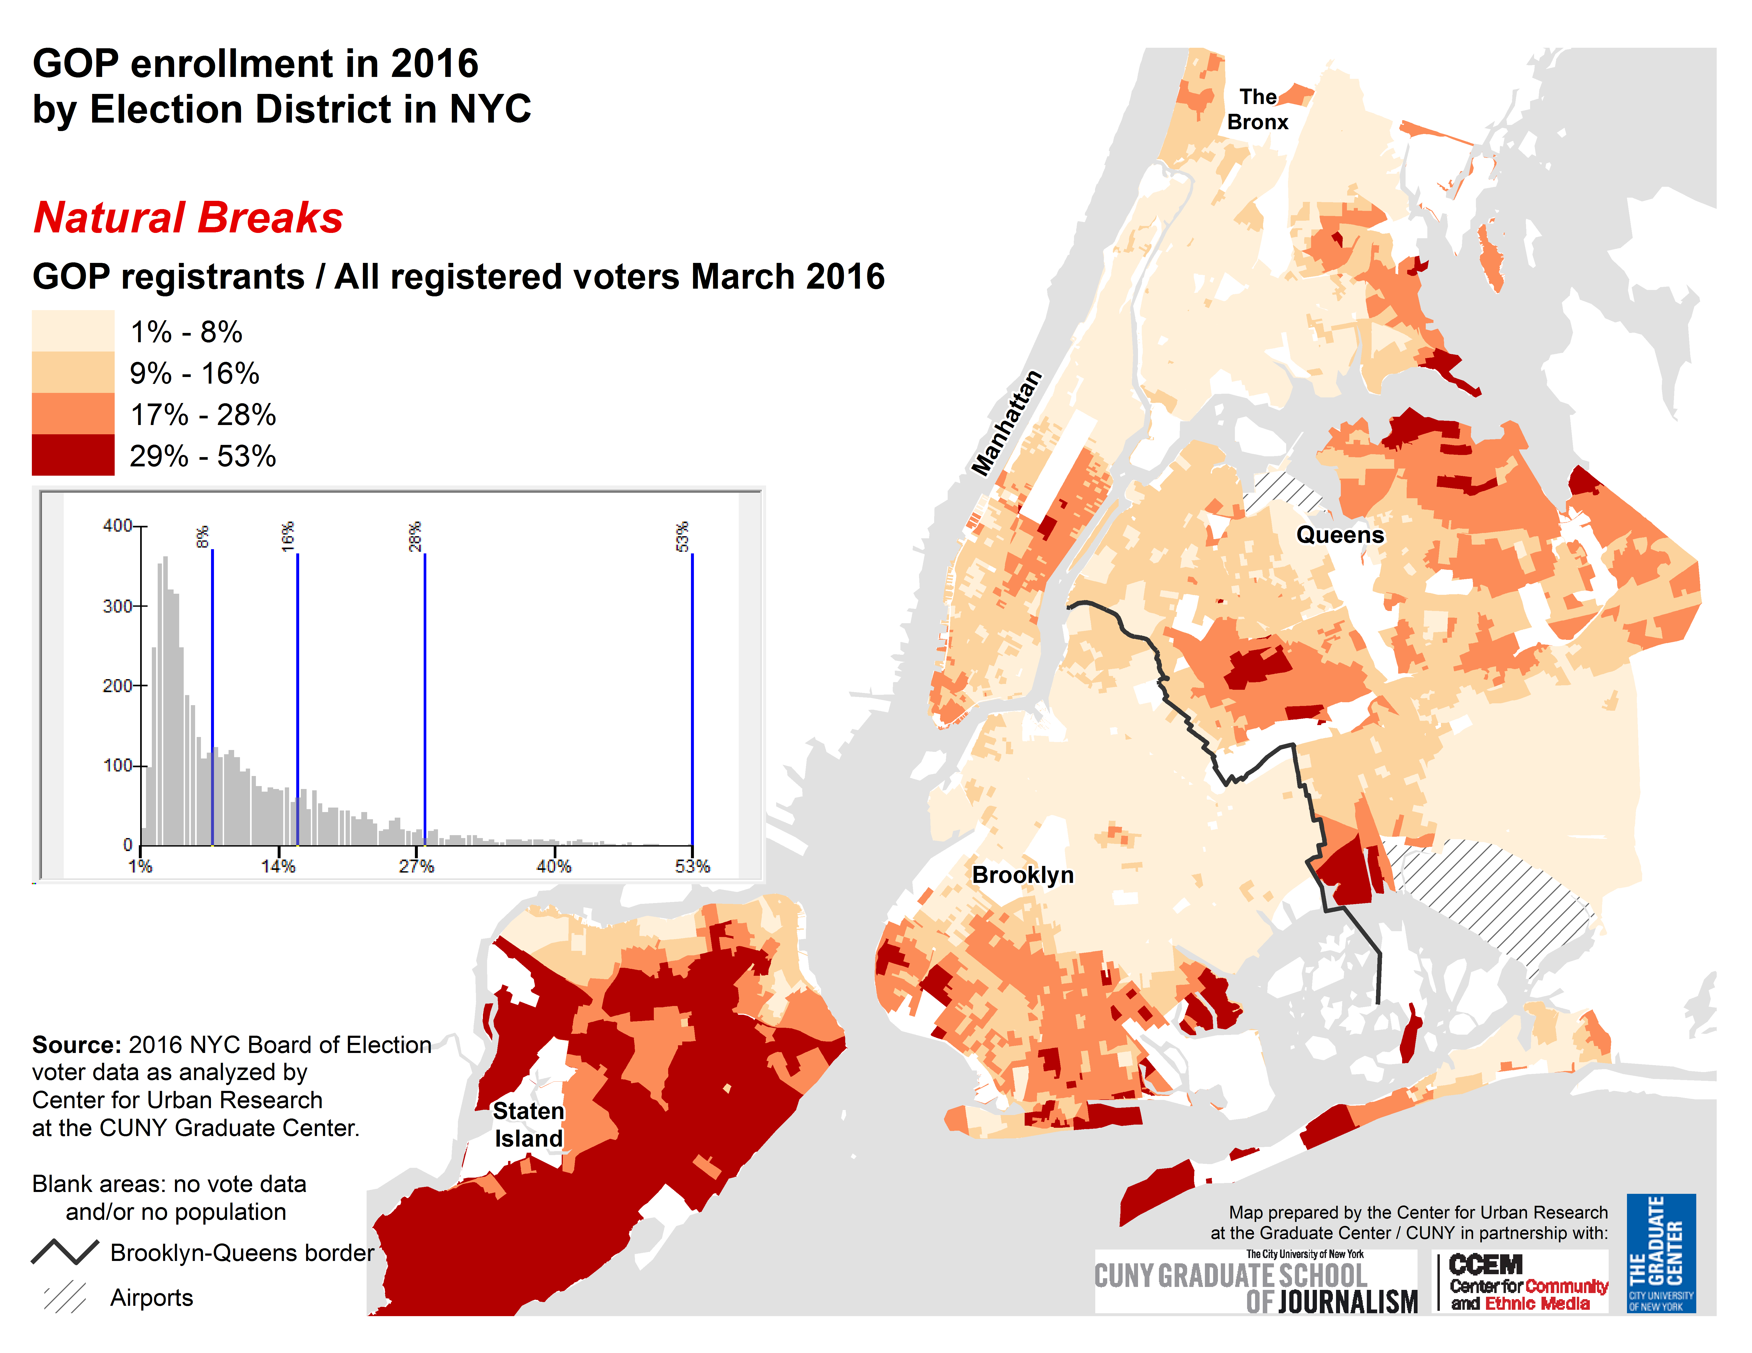
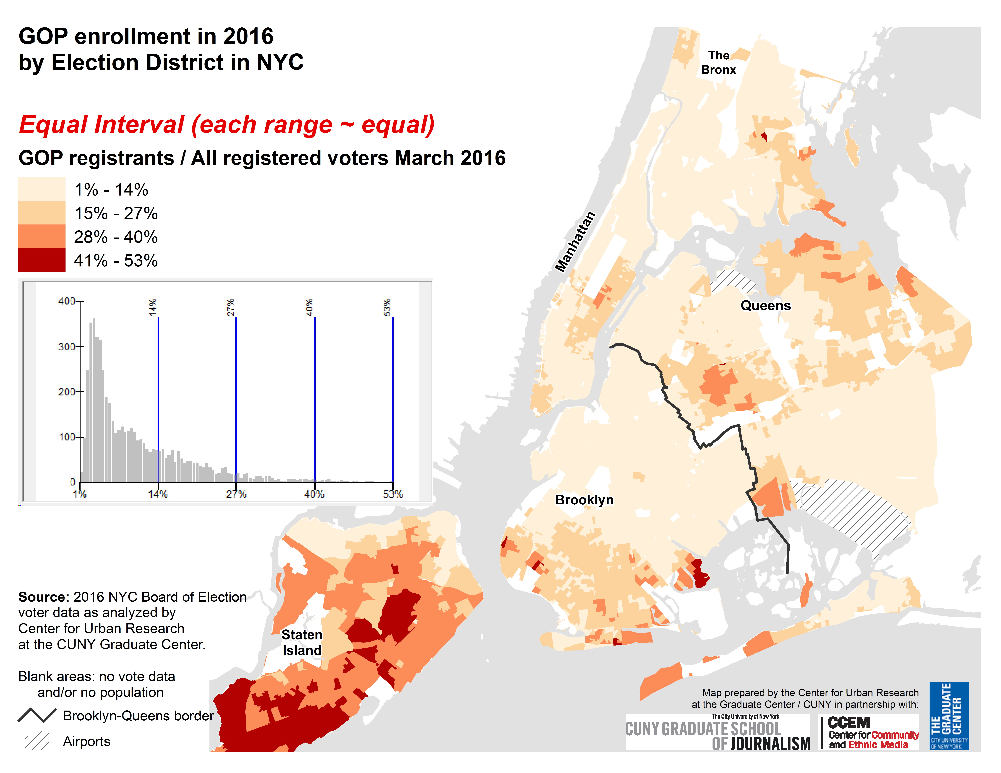

Slide 15
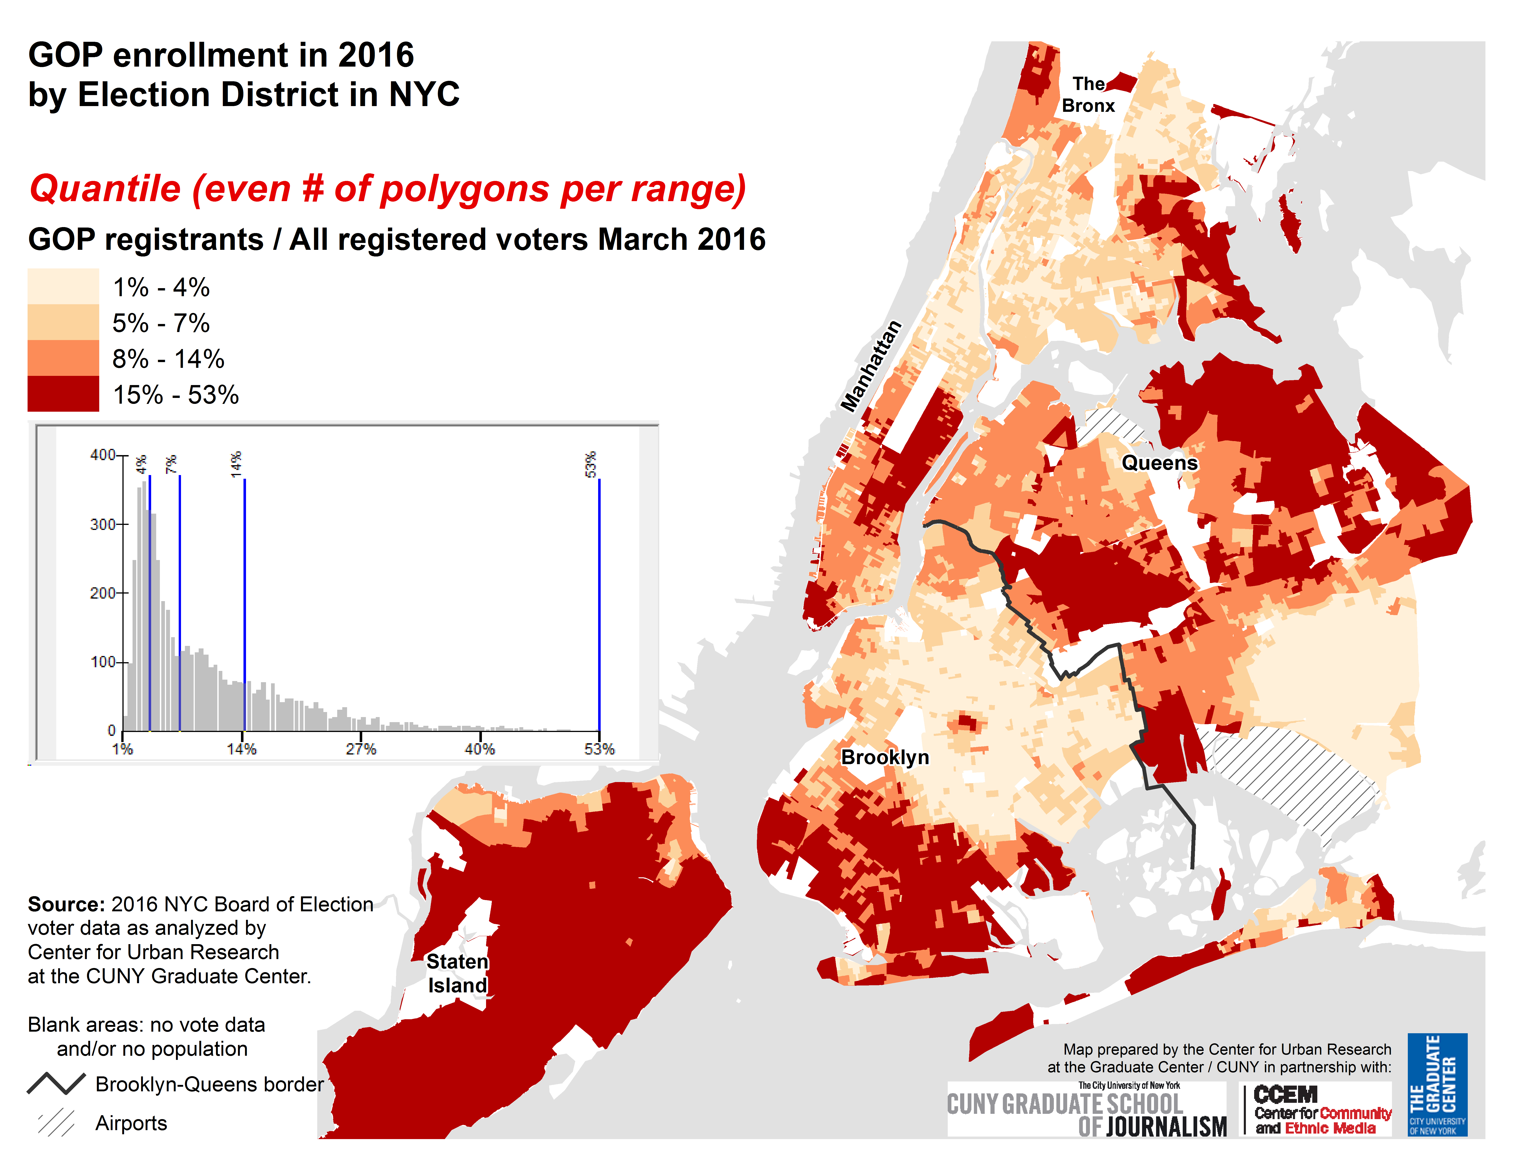
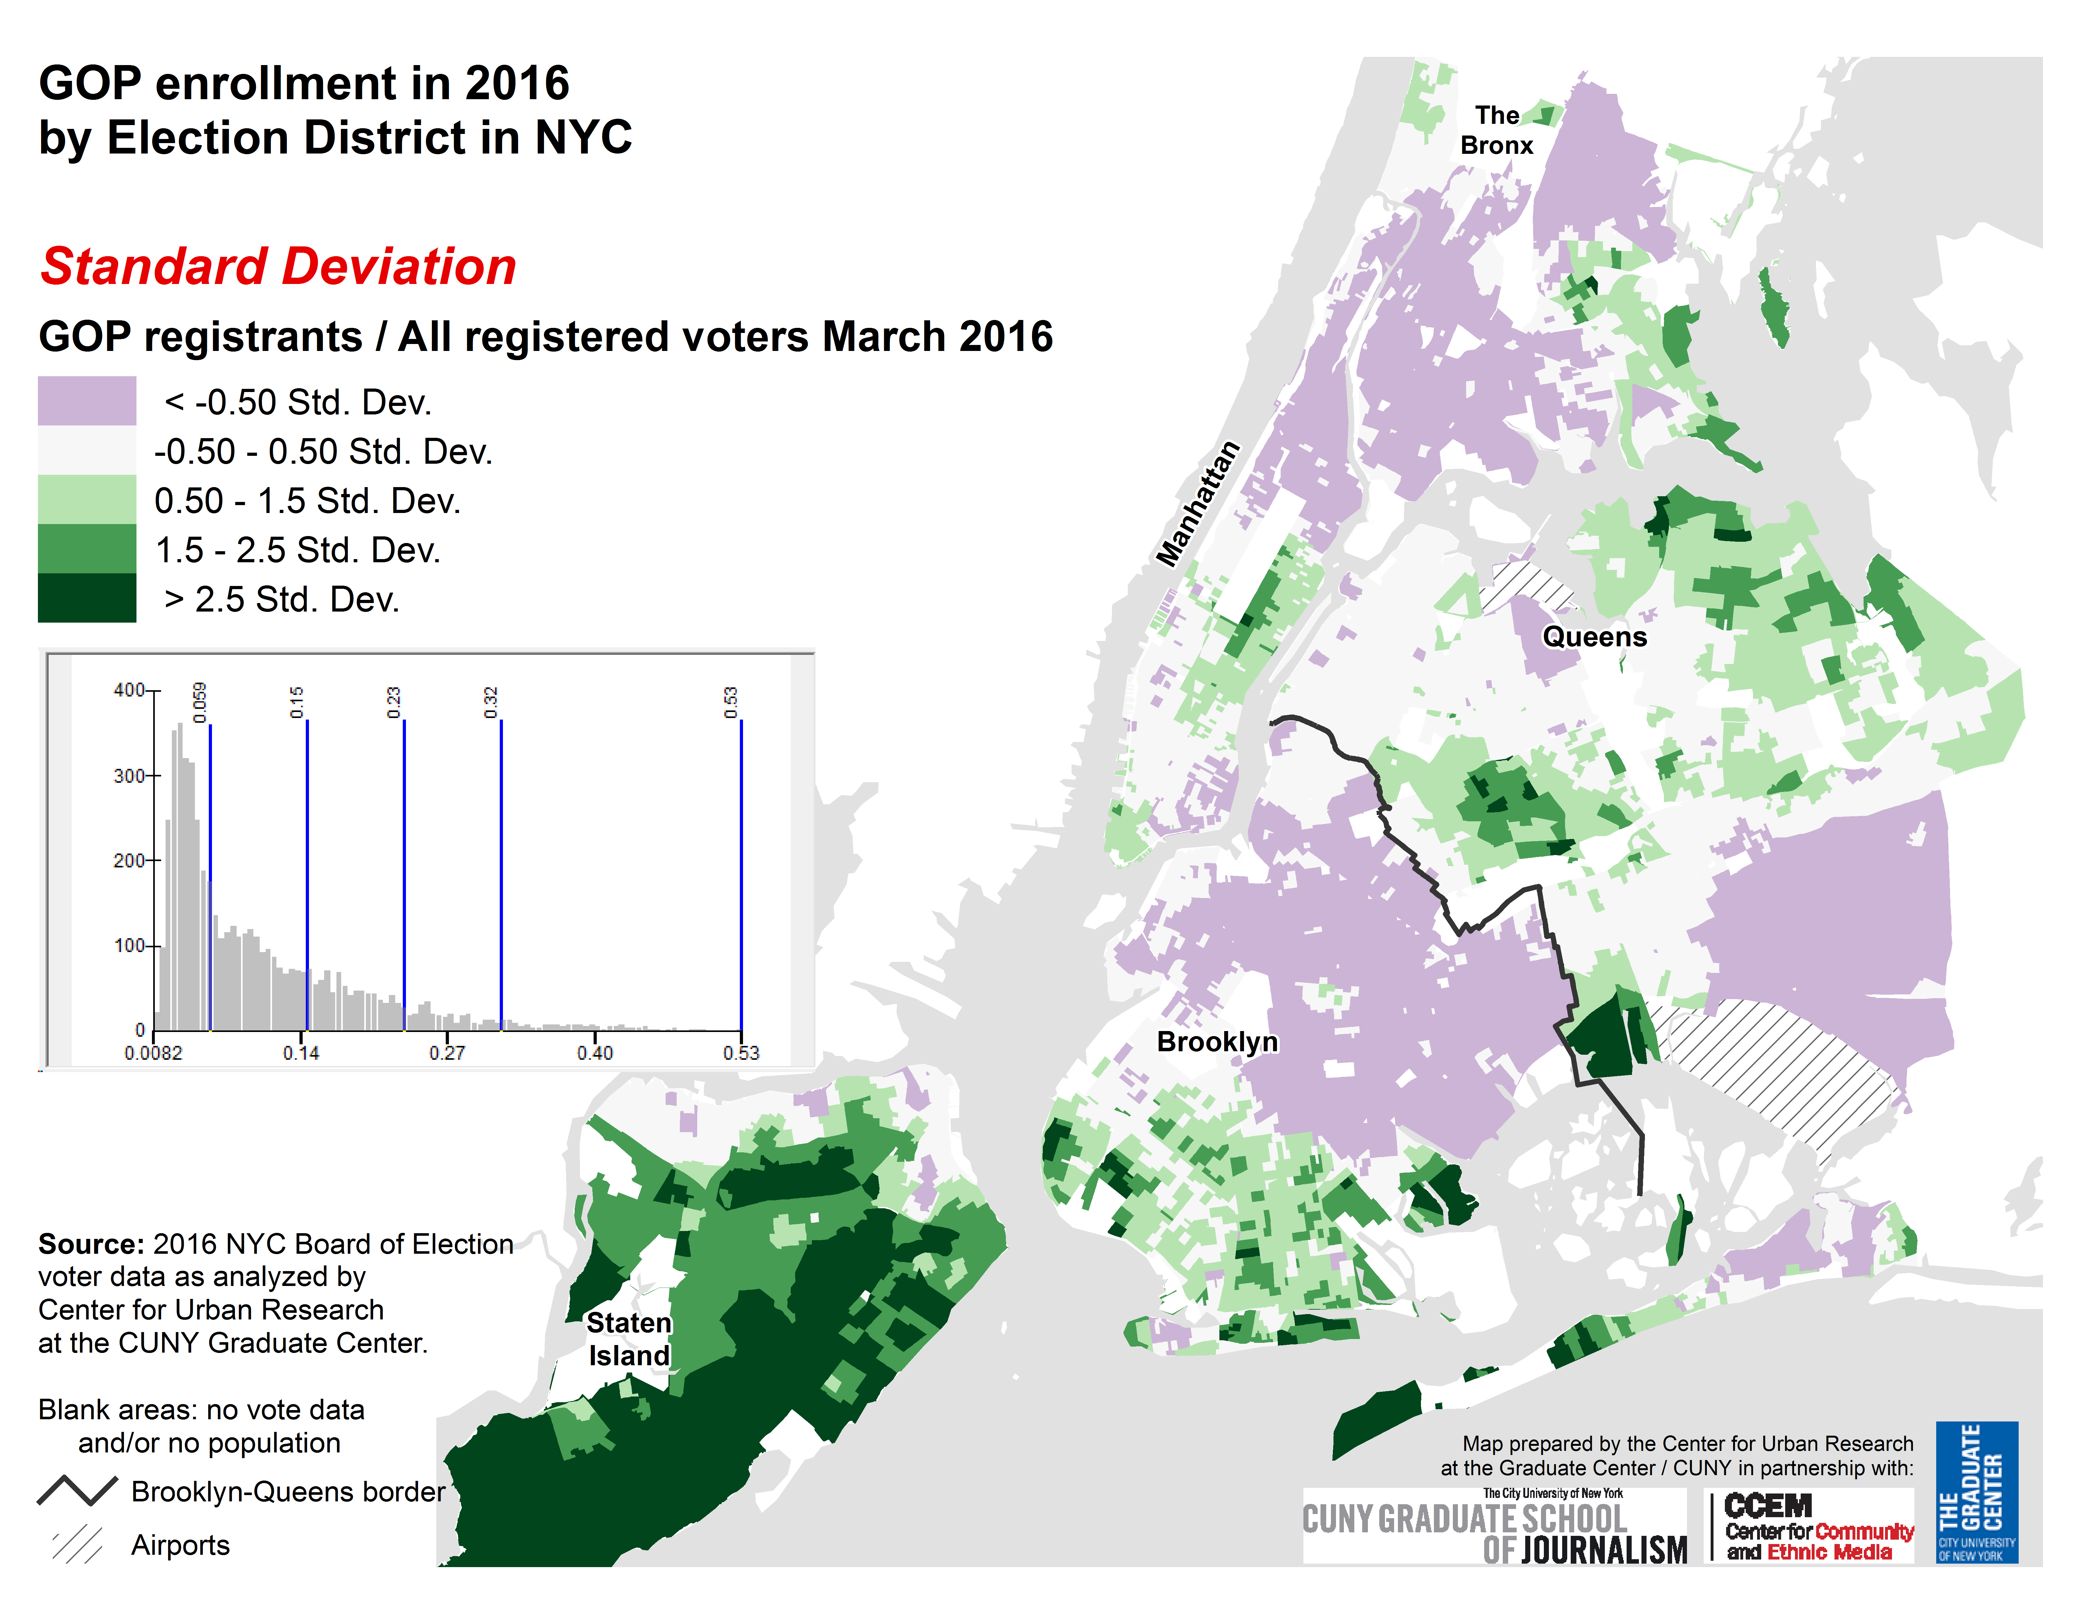

Slide 16
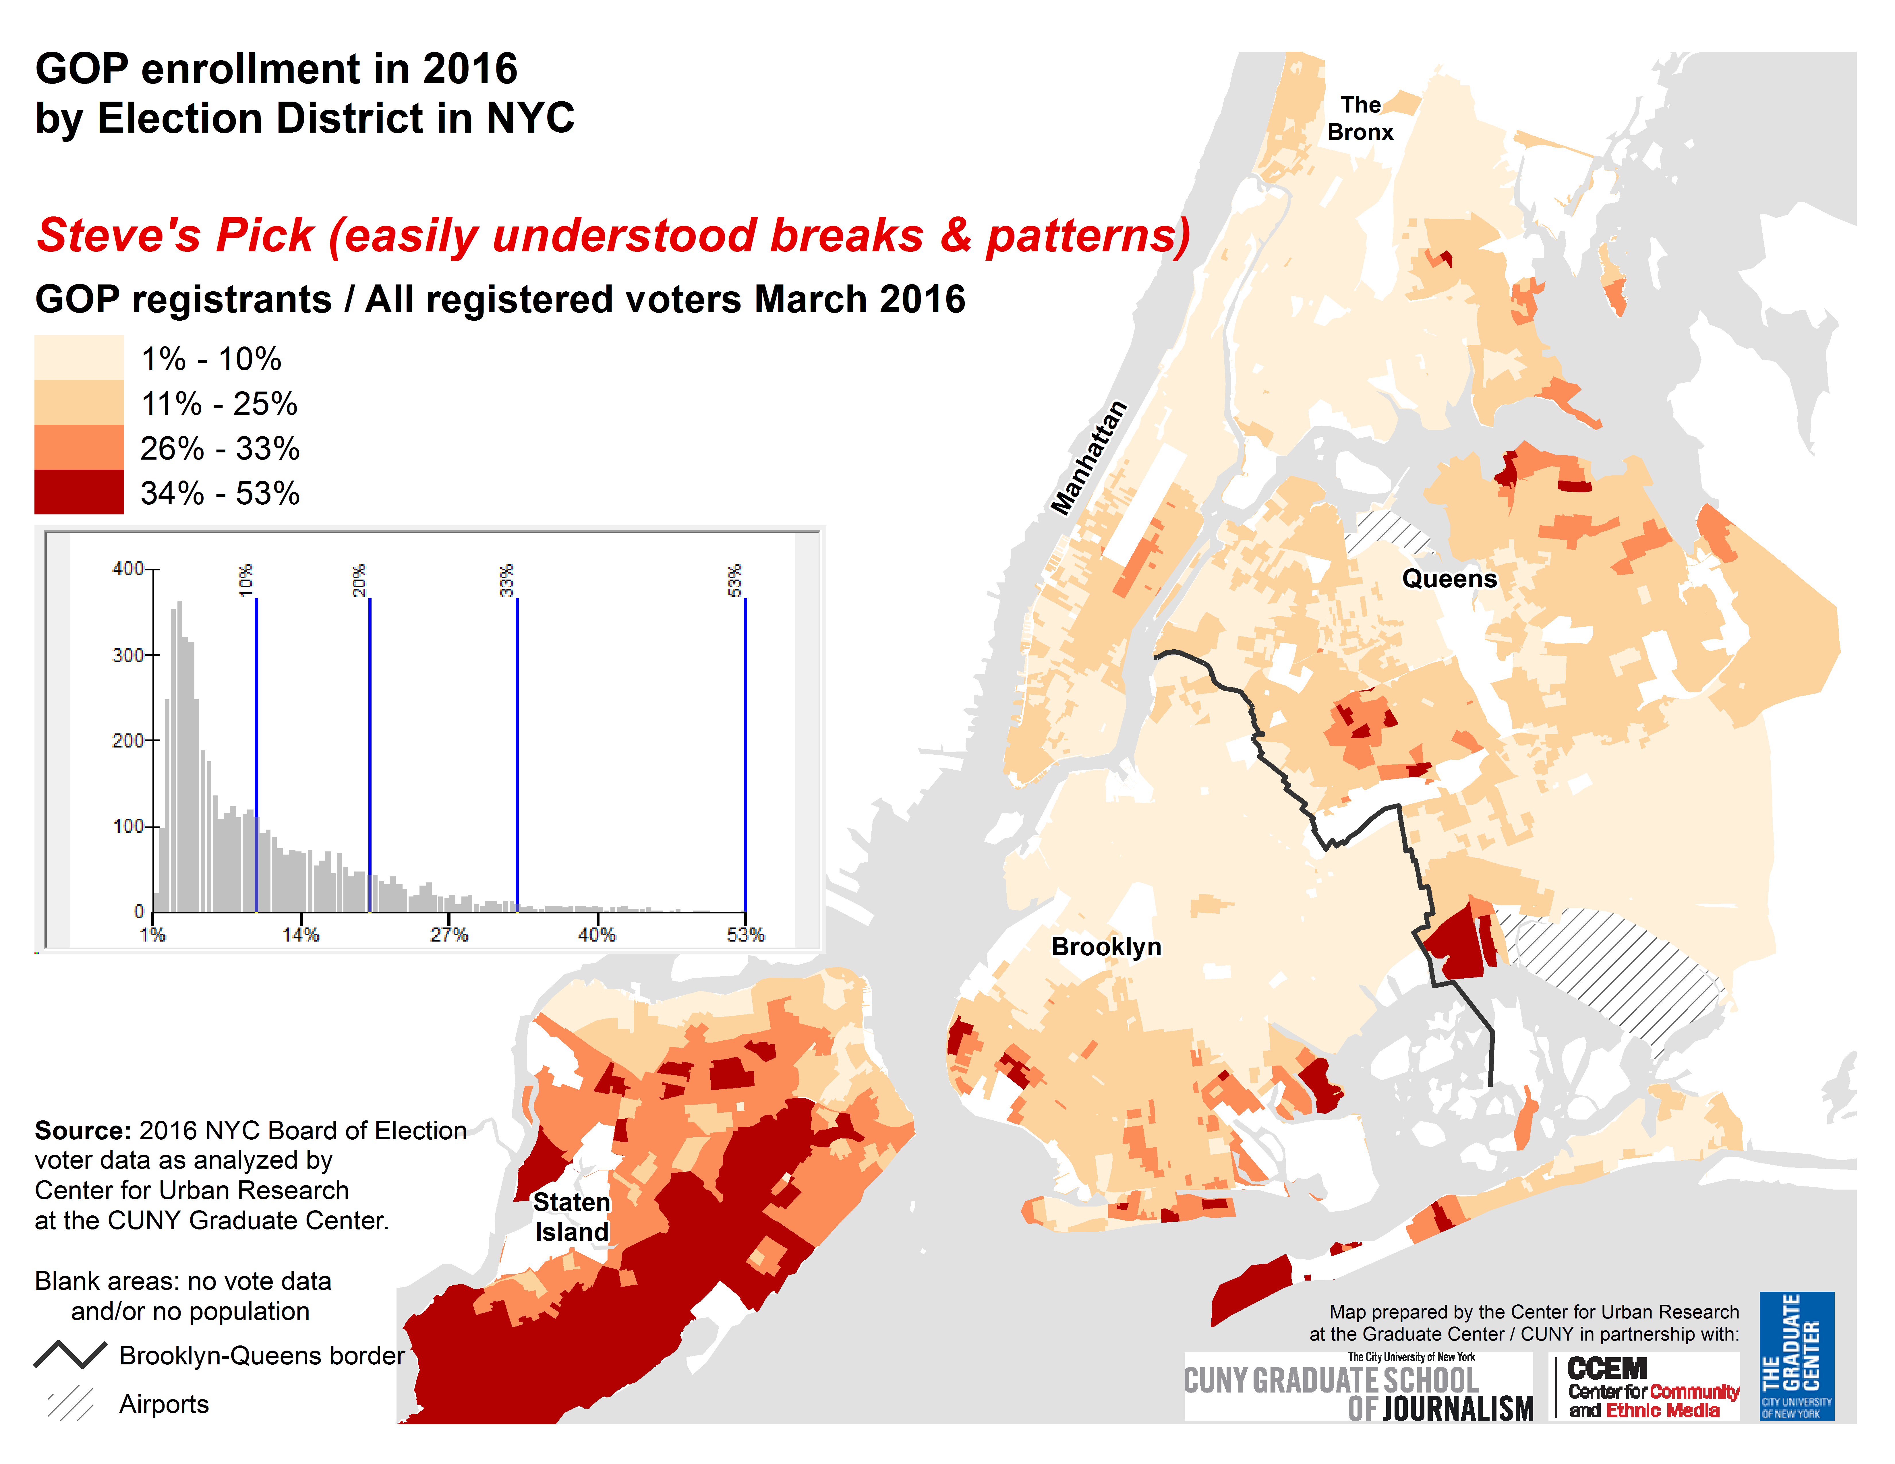

Slide 17
How to Lie with Maps, Third Edition
Mark Monmonier
https://press.uchicago.edu/ucp/books/book/chicago/H/bo27400568.html

Slide 18
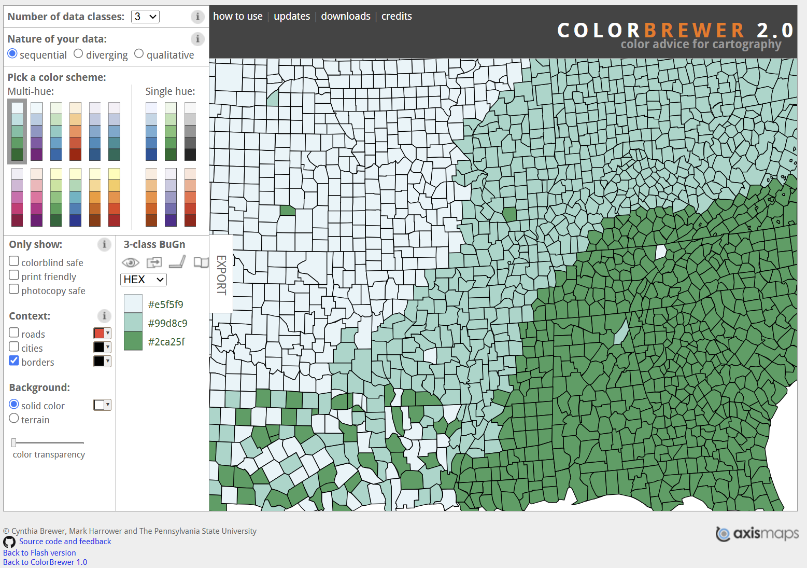
https://colorbrewer2.org/

Slide 19
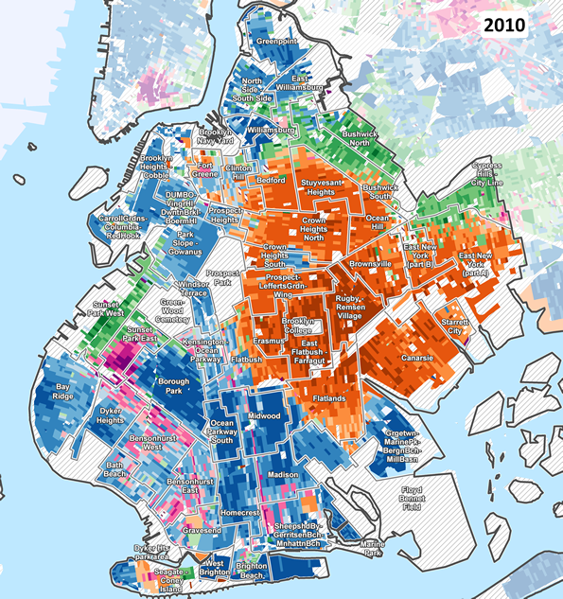
ColorBrewer in action
https://www.urbanresearchmaps.org/plurality/blockmaps.htm

Slide 20
Interactive maps … some examples
Intuitive?
Redistricting & You
NYC Ranked Choice Voting 2021
Long Island Zoning Atlas
Data / feature rich!
Audubon Bird Migration Explorer
Not so intuitive?
NYS Pesticides Map / Cornell
NYC Urban Agriculture
US Natural Hazards Index

